Slide 1
BIOS27816: Population biology of infectious diseases of global health concern
Transmission dynamics and interventions for Vector-Borne Diseases
UChicago Center in Paris
Paris, France
January 2024

Slide 2
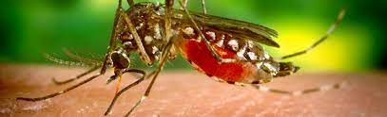
Pathogens exhibit diverse transmission mechanisms that require tailored modeling structures
Vector-borne diseases (a type of indirect transmission) are transmitted via blood-feeding arthropod (mosquitoes, ticks, fleas)
Euclidean vector: a quantity with a magnitude and direction
Epidemiological vector: an agent that carries and transmits an infectious patient into another living organism
Notes:
Kissing bugs = hemiptera = true bugs

Slide 3
Pathogens exhibit diverse transmission mechanisms that require tailored modeling structures
Vector-borne diseases (a type of indirect transmission) are transmitted via blood-feeding arthropod (mosquitoes, ticks, fleas)
Malaria: Mosquito-borne protozoan Plasmodium spp.
“Arboviruses”: Mosquito-borne viruses, including Dengue, Zika, Yellow fever virus, West Nile virus, Chikungunya virus
Sleeping sickness, also known as African trypanosomiasis: tsetse fly vector and protozoan pathogen (trypanosome)
Chagas disease: kissing bug vector and trypanosome pathogen
Plague: flea vector and bacterial pathogen (Yersinia pestis)
Notes:
Kissing bugs = hemiptera = true bugs

Slide 4
Pathogens exhibit diverse transmission mechanisms that require tailored modeling structures
Vector-borne diseases (a type of indirect transmission) are transmitted via blood-feeding arthropod (mosquitoes, ticks, fleas)
Malaria: Mosquito-borne protozoan Plasmodium spp.
“Arboviruses”: Mosquito-borne viruses, including Dengue, Zika, Yellow fever virus, West Nile virus, Chikungunya virus
Sleeping sickness, also known as African trypanosomiasis: tsetse fly vector and protozoan pathogen (trypanosome)
Chagas disease: kissing bug vector and trypanosome pathogen
Plague: flea vector and bacterial pathogen (Yersinia pestis)
Notes:
Kissing bugs = hemiptera = true bugs

Slide 5
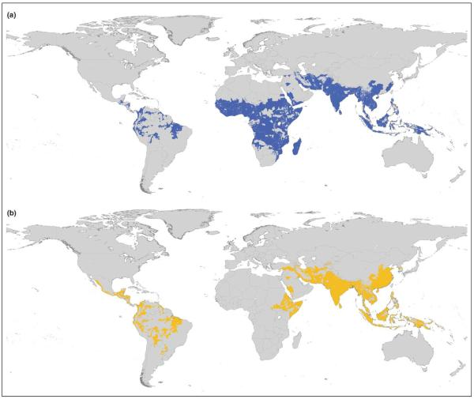
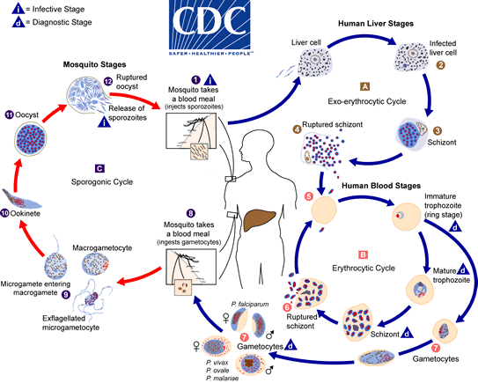
Malaria
4 main human Plasmodium parasites (falciparum, vivax, malariae, ovalae).
Over 200 Plasmodium spp. globally, infecting birds, reptiles, and other mammals (rodents, bats, primates)
Distribution Plasmodium falciparum
Distribution Plasmodium vivax
Guerra et al. 2006. Trends in Parasitology

Slide 6
Malaria
4 main human Plasmodium parasites (falciparum, vivax, malariae, ovalae).
Over 200 Plasmodium spp. globally, infecting birds, reptiles, and other mammals (rodents, bats, primates)
Distribution Plasmodium falciparum
Distribution Plasmodium vivax
Plasmodium parasites time RBC bursting such that they are at peak blood stage circulation when mosquito vectors are feeding at dusk!
Guerra et al. 2006. Trends in Parasitology

Slide 7
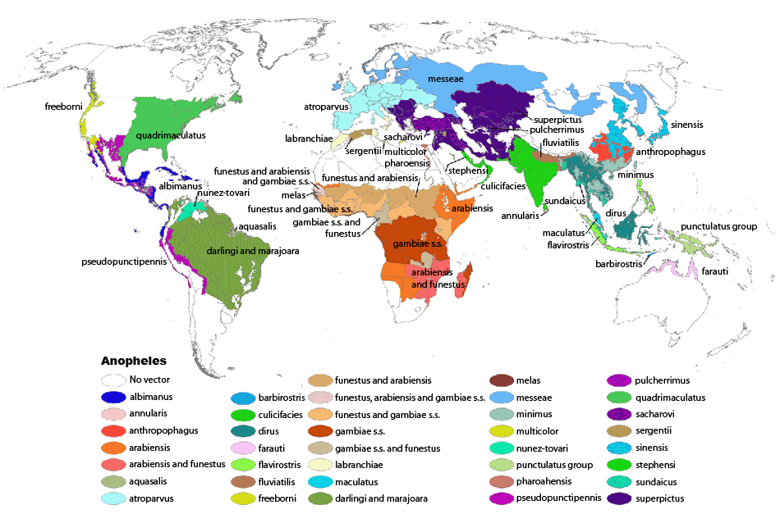
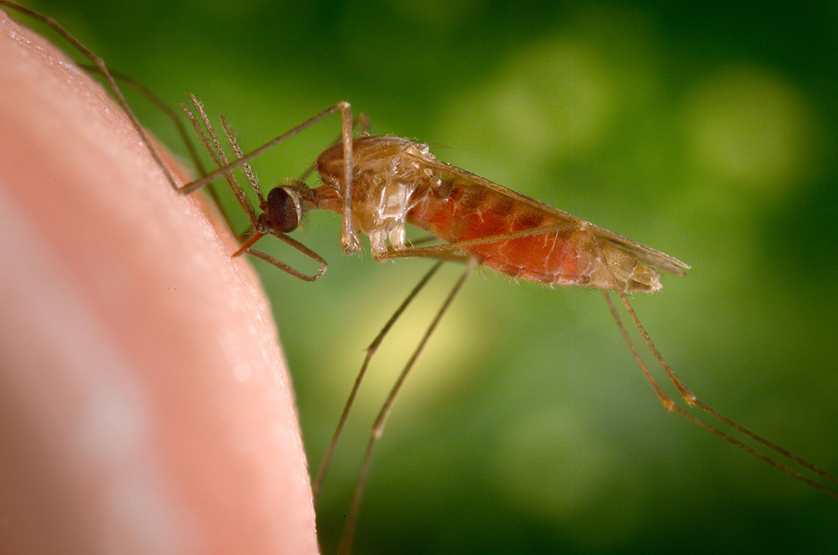
Malaria
4 main human Plasmodium parasites (falciparum, vivax, malariae, ovalae).
Over 200 Plasmodium spp. globally, infecting birds, reptiles, and other mammals (rodents, bats, primates)
>400 global species of Anopheles mosquito, >100 that can transmit human malaria
~30-40 Anopheles spp. most commonly implicated in human malaria transmission!
Kiszewksi et al. 2004. ASTMH.

Slide 8
Malaria
4 main human Plasmodium parasites (falciparum, vivax, malariae, ovalae).
Over 200 Plasmodium spp. globally, infecting birds, reptiles, and other mammals (rodents, bats, primates)
>400 global species of Anopheles mosquito, >100 that can transmit human malaria
~30-40 Anopheles spp. most commonly implicated in human malaria transmission!
Only female mosquitoes feed on blood!
Male mosquitoes feed on plant nectar.
Kiszewksi et al. 2004. ASTMH.

Slide 9
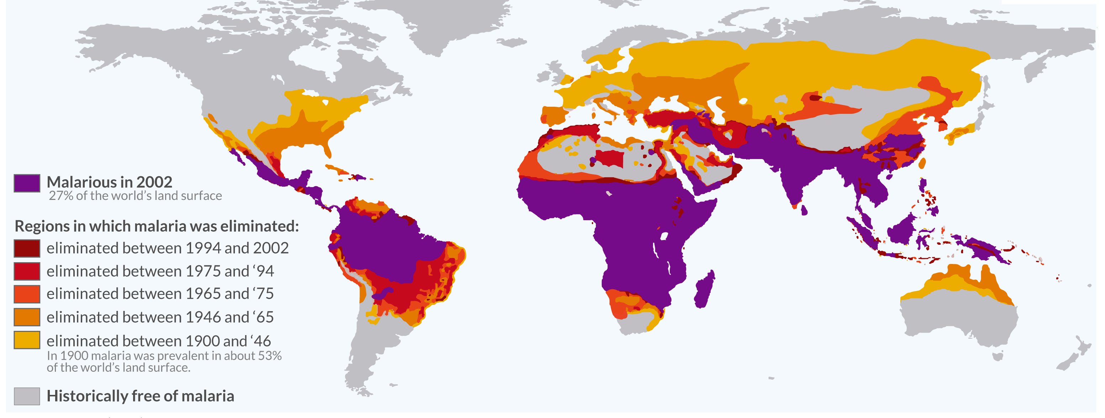
Malaria has been eliminated from many regions where it was previously endemic, including the US.
Still one of the leading causes of child mortality globally – responsible for about half a million childhood deaths a year, 80% in Africa.
OurWorldinData.org

Slide 10

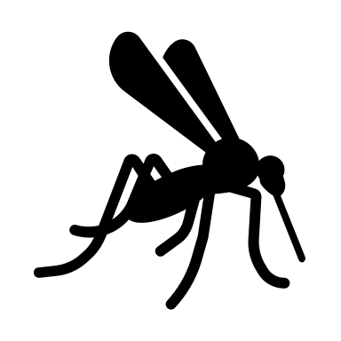
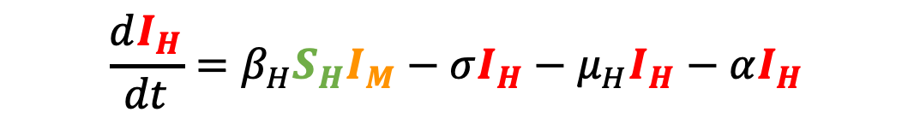
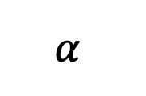
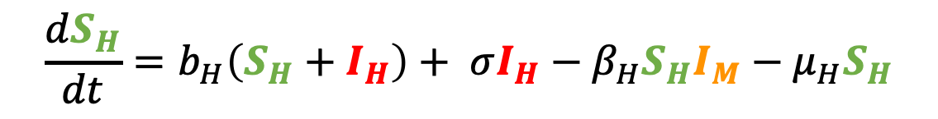

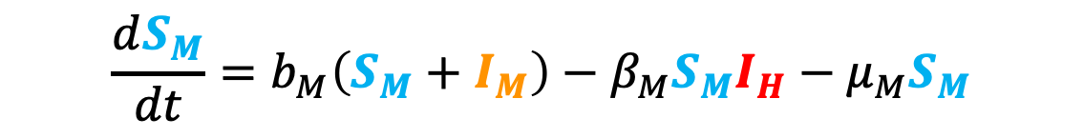
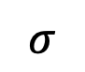
Malaria models have played a critical role in public health policy for over a century.
$$σ$$
1911: British medical Dr. Sir Ronald Ross developed the first model of malaria while working in the Indian Medical Service.
He had already won the 1902 Nobel prize in physiology and medicine for discovering the life cycle of avian malaria
μ_{H}
μ_{H}
b_{H}
β_{H}
$$α$$
S_{H}
I_{H}
$$\frac{dS_{H}}{dt}=b_{H}\left(S_{H}+I_{H}\right)+ σI_{H}−β_{H}S_{H}I_{M}−μ_{H}S_{H}$$
b_{M}
S_{M}
β_{M}
I_{M}
$$\frac{dI_{H}}{dt}=β_{H}S_{H}I_{M}−σI_{H}−μ_{H}I_{H}−αI_{H}$$
μ_{M}
μ_{M}
$$\frac{dS_{M}}{dt}=b_{M}\left(S_{M}+I_{M}\right)−β_{M}S_{M}I_{H}−μ_{M}S_{M}$$
$$\frac{dI_{M}}{dt}=β_{M}S_{M}I_{H}−μ_{M}I_{M}$$

Slide 11

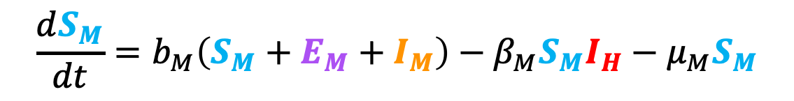
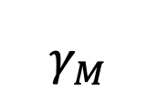

Malaria models have played a critical role in public health policy for over a century.
$$σ$$
1911: British medical Dr. Sir Ronald Ross developed the first model of malaria while working in the Indian Medical Service.
1957: MacDonald modified this model to include the latent period of the parasite developing in the mosquito.
He implicated the survivorship of the female mosquito as the weakest link in the life cycle!
μ_{H}
μ_{H}
b_{H}
β_{H}
$$α$$
S_{H}
I_{H}
b_{M}
β_{M}
$$γ_{M}$$
S_{M}
E_{M}
I_{M}
$$\frac{dS_{M}}{dt}=b_{M}\left(S_{M}+E_{M}+I_{M}\right)−β_{M}S_{M}I_{H}−μ_{M}S_{M}$$
μ_{M}
μ_{M}
μ_{M}
$$\frac{dE_{M}}{dt}=β_{M}S_{M}I_{H}−μ_{M}E_{M}−γ_{M}E_{M}$$
$$\frac{dI_{M}}{dt}=γ_{M}E_{M}−μ_{M}I_{M}$$

Slide 12
Malaria models have played a critical role in public health policy for over a century.
$$σ$$
1911: British medical Dr. Sir Ronald Ross developed the first model of malaria while working in the Indian Medical Service.
1957: MacDonald modified this model to include the latent period of the parasite developing in the mosquito.
This led to a widespread WHO campaign for malaria elimination using DDT in the 1950s!
Swiss chemist Paul Müller awarded 1948 Nobel Prize in medicine and physiology for discovering DDT and its impacts on arthropods
DDT played a major role in eliminating malaria from Europe and North America
DDT bioaccumulates and is carcinogenic – led to development of an environmental backlash in the US, culminating in Rachel Carson’s 1962 book Silent Spring
DDT banned globally in 2004, excepting in cases of WHO-recommended indoor residual spraying (IRS) for vector control in malaria-endemic regions
μ_{H}
μ_{H}
b_{H}
β_{H}
$$α$$
S_{H}
I_{H}
b_{M}
β_{M}
$$γ_{M}$$
S_{M}
E_{M}
I_{M}
μ_{M}
μ_{M}
μ_{M}

Slide 13
Malaria models have played a critical role in public health policy for over a century.
$$σ$$
1911: British medical Dr. Sir Ronald Ross developed the first model of malaria while working in the Indian Medical Service.
1957: MacDonald modified this model to include the latent period of the parasite developing in the mosquito.
This led to a widespread WHO campaign for malaria elimination using DDT in the 1950s!
Swiss chemist Paul Müller awarded 1948 Nobel Prize in medicine and physiology for discovering DDT and its impacts on arthropods
DDT played a major role in eliminating malaria from Europe and North America
DDT bioaccumulates and is carcinogenic – led to development of an environmental backlash in the US, culminating in Rachel Carson’s 1962 book Silent Spring
DDT banned globally in 2004, excepting in cases of WHO-recommended indoor residual spraying (IRS) for vector control in malaria-endemic regions
μ_{H}
μ_{H}
b_{H}
β_{H}
$$α$$
S_{H}
I_{H}
b_{M}
β_{M}
$$γ_{M}$$
S_{M}
E_{M}
I_{M}
μ_{M}
μ_{M}
μ_{M}

Slide 14
Malaria models have played a critical role in public health policy for over a century.
$$σ$$
1911: British medical Dr. Sir Ronald Ross developed the first model of malaria while working in the Indian Medical Service.
1957: MacDonald modified this model to include the latent period of the parasite developing in the mosquito.
This led to a widespread WHO campaign for malaria elimination using DDT in the 1950s!
Swiss chemist Paul Müller awarded 1948 Nobel Prize in medicine and physiology for discovering DDT and its impacts on arthropods
DDT played a major role in eliminating malaria from Europe and North America
DDT bioaccumulates and is carcinogenic – led to development of an environmental backlash in the US, culminating in Rachel Carson’s 1962 book Silent Spring
DDT banned globally in 2004, excepting in cases of WHO-recommended indoor residual spraying (IRS) for vector control in malaria-endemic regions
μ_{H}
μ_{H}
b_{H}
β_{H}
$$α$$
S_{H}
I_{H}
b_{M}
β_{M}
$$γ_{M}$$
S_{M}
E_{M}
I_{M}
μ_{M}
μ_{M}
μ_{M}

Slide 15
Malaria models have played a critical role in public health policy for over a century.
$$σ$$
1911: British medical Dr. Sir Ronald Ross developed the first model of malaria while working in the Indian Medical Service.
1957: MacDonald modified this model to include the latent period of the parasite developing in the mosquito.
This led to a widespread WHO campaign for malaria elimination using DDT in the 1950s!
Swiss chemist Paul Müller awarded 1948 Nobel Prize in medicine and physiology for discovering DDT and its impacts on arthropods
DDT played a major role in eliminating malaria from Europe and North America
DDT bioaccumulates and is carcinogenic – led to development of an environmental backlash in the US, culminating in Rachel Carson’s 1962 book Silent Spring
DDT banned globally in 2004, excepting in cases of WHO-recommended indoor residual spraying (IRS) for vector control in malaria-endemic regions
μ_{H}
μ_{H}
b_{H}
β_{H}
$$α$$
S_{H}
I_{H}
b_{M}
β_{M}
$$γ_{M}$$
S_{M}
E_{M}
I_{M}
μ_{M}
μ_{M}
μ_{M}

Slide 16
Malaria models have played a critical role in public health policy for over a century.
$$σ$$
1911: British medical Dr. Sir Ronald Ross developed the first model of malaria while working in the Indian Medical Service.
1957: MacDonald modified this model to include the latent period of the parasite developing in the mosquito.
This led to a widespread WHO campaign for malaria elimination using DDT in the 1950s!
Swiss chemist Paul Müller awarded 1948 Nobel Prize in medicine and physiology for discovering DDT and its impacts on arthropods
DDT played a major role in eliminating malaria from Europe and North America
DDT bioaccumulates and is carcinogenic – led to development of an environmental backlash in the US, culminating in Rachel Carson’s 1962 book Silent Spring
DDT banned globally in 2004, excepting in cases of WHO-recommended indoor residual spraying (IRS) for vector control in malaria-endemic regions
μ_{H}
μ_{H}
b_{H}
β_{H}
$$α$$
S_{H}
I_{H}
b_{M}
β_{M}
$$γ_{M}$$
S_{M}
E_{M}
I_{M}
μ_{M}
μ_{M}
μ_{M}

Slide 17
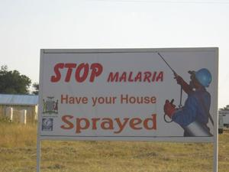
Malaria models have played a critical role in public health policy for over a century.
1911: British medical Dr. Sir Ronald Ross developed the first model of malaria while working in the Indian Medical Service.
1957: MacDonald modified this model to include the latent period of the parasite developing in the mosquito.
This led to a widespread WHO campaign for malaria elimination using DDT in the 1950s!
Swiss chemist Paul Müller awarded 1948 Nobel Prize in medicine and physiology for discovering DDT and its impacts on arthropods
DDT played a major role in eliminating malaria from Europe and North America
DDT bioaccumulates and is carcinogenic – led to development of an environmental backlash in the US, culminating in Rachel Carson’s 1962 book Silent Spring
DDT banned globally in 2004, excepting in cases of WHO-recommended indoor residual spraying (IRS) for vector control in malaria-endemic regions

Slide 18
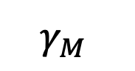
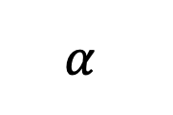
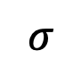


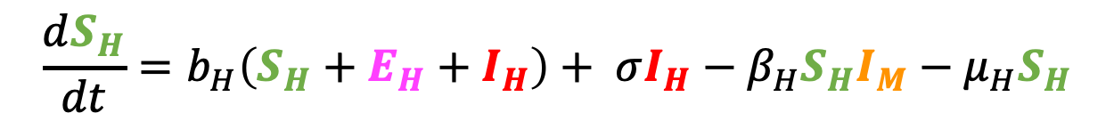
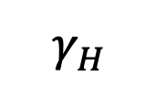
Malaria models have played a critical role in public health policy for over a century.
1911: British medical Dr. Sir Ronald Ross developed the first model of malaria while working in the Indian Medical Service.
1957: MacDonald modified this model to include the latent period of the parasite in the mosquito.
This led to a widespread WHO campaign for malaria elimination using DDT in the 1950s!
1991: Anderson and May extended model to show latency in the human population.
$$σ$$
μ_{H}
μ_{H}
μ_{H}
b_{H}
β_{H}
S_{H}
E_{H}
$$γ_{H}$$
I_{H}
$$α$$
b_{M}
S_{M}
β_{M}
E_{M}
$$γ_{M}$$
I_{M}
μ_{M}
μ_{M}
μ_{M}
$$\frac{dS_{H}}{dt}=b_{H}\left(S_{H}+E_{H}+I_{H}\right)+ σI_{H}−β_{H}S_{H}I_{M}−μ_{H}S_{H}$$
$$\frac{dE_{H}}{dt}=β_{H}S_{H}I_{M}−γ_{H}E_{H}−μ_{H}E_{H}$$
$$\frac{dI_{H}}{dt}=γ_{H}E_{H}−σI_{H}−μ_{H}I_{H}−αI_{H}$$

Slide 19
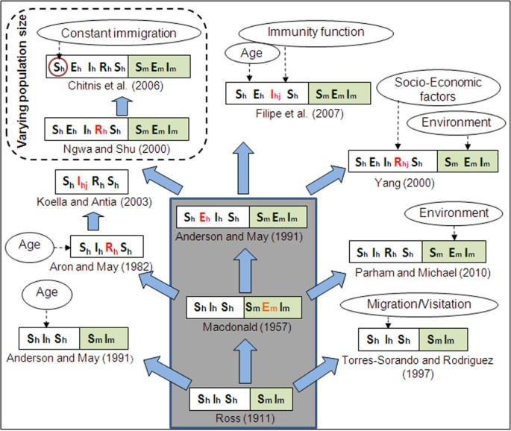
Malaria models have played a critical role in public health policy for over a century.
Mandal et al. 2011. Malaria Journal.

Slide 20
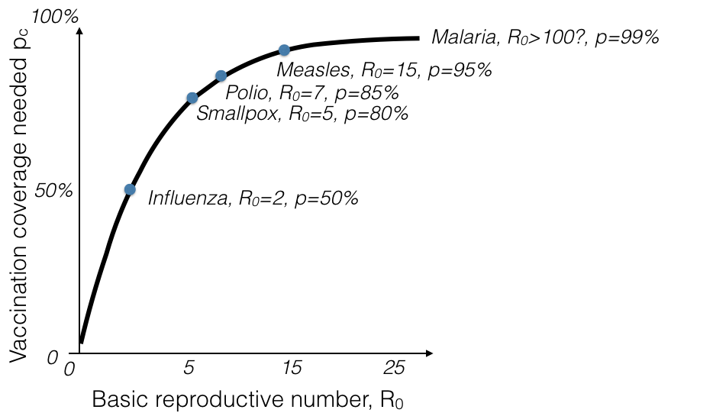
Challenges to malaria elimination
Herd immunity threshold (HIT)

Slide 21
Challenges to malaria elimination?

Slide 22
Challenges to malaria elimination?
High parasite diversity: sexual reproduction in 4+ Plasmodium species
Fast evolution of resistance (e.g. to drugs)
Many possible vectors! Potentially additional possible reservoirs!
Latent cases as burden is reduced
Vaccine candidates: what life stage to target?

Slide 23
Challenges to malaria elimination?
High parasite diversity: sexual reproduction in 4+ Plasmodium species
Fast evolution of resistance (e.g. to drugs)
Many possible vectors! Potentially additional possible reservoirs!
Latent cases as burden is reduced
Vaccine candidates: what life stage to target?

Slide 24
Challenges to malaria elimination?
High parasite diversity: sexual reproduction in 4+ Plasmodium species
Fast evolution of resistance (e.g. to drugs)
Many possible vectors! Potentially additional possible reservoirs!
Latent cases as burden is reduced
Vaccine candidates: what life stage to target?

Slide 25
Challenges to malaria elimination?
High parasite diversity: sexual reproduction in 4+ Plasmodium species
Fast evolution of resistance (e.g. to drugs)
Many possible vectors! Potentially additional possible reservoirs!
Latent cases as burden is reduced
Vaccine candidates: what life stage to target?

Slide 26
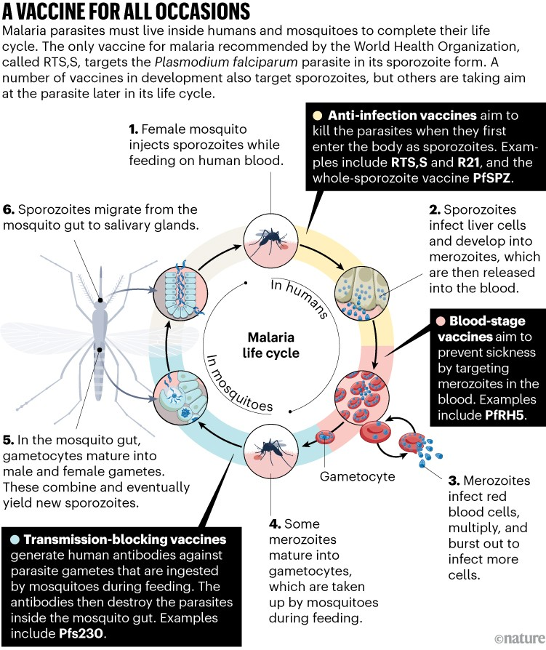
Malaria vaccines
Only two currently licensed
Mosquirix/RTS,S pre-erythrocytic vaccine licensed in 2022
Requires at least 3 doses in children <2
Does not eliminate pathogen but reduces severe malaria burden and burden of hospitalization by ~30%
R21/Matrix-M pre-erythrocytic vaccine licensed in 2023
Requires at least 3 doses in children <2
Does not eliminate pathogen but reduces severe malaria burden and burden of hospitalization by 77%

Slide 27
Pathogens exhibit diverse transmission mechanisms that require tailored modeling structures
Vector-borne diseases (a type of indirect transmission) are transmitted via blood-feeding arthropod (mosquitoes, ticks, fleas)
Malaria: Mosquito-borne protozoan Plasmodium spp.
“Arboviruses”: Mosquito-borne viruses, including Dengue, Zika, Yellow fever virus, West Nile virus, Chikungunya virus
Sleeping sickness, also known as African trypanosomiasis: tsetse fly vector and protozoan pathogen (trypanosome)
Chagas disease: kissing bug vector and trypanosome pathogen
Plague: flea vector and bacterial pathogen (Yersinia pestis)
Notes:
Kissing bugs = hemiptera = true bugs

Slide 28
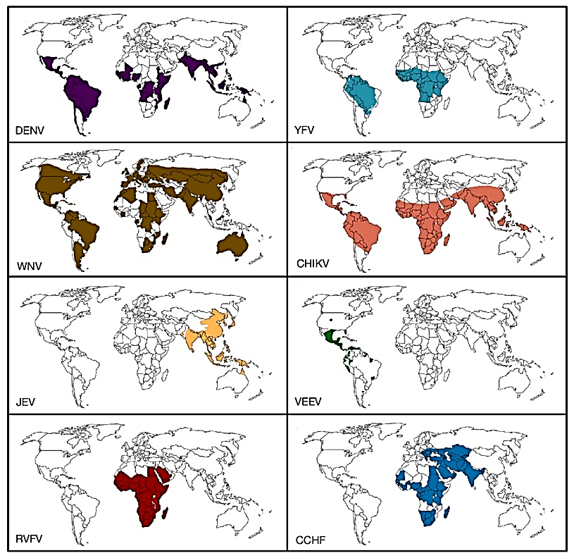
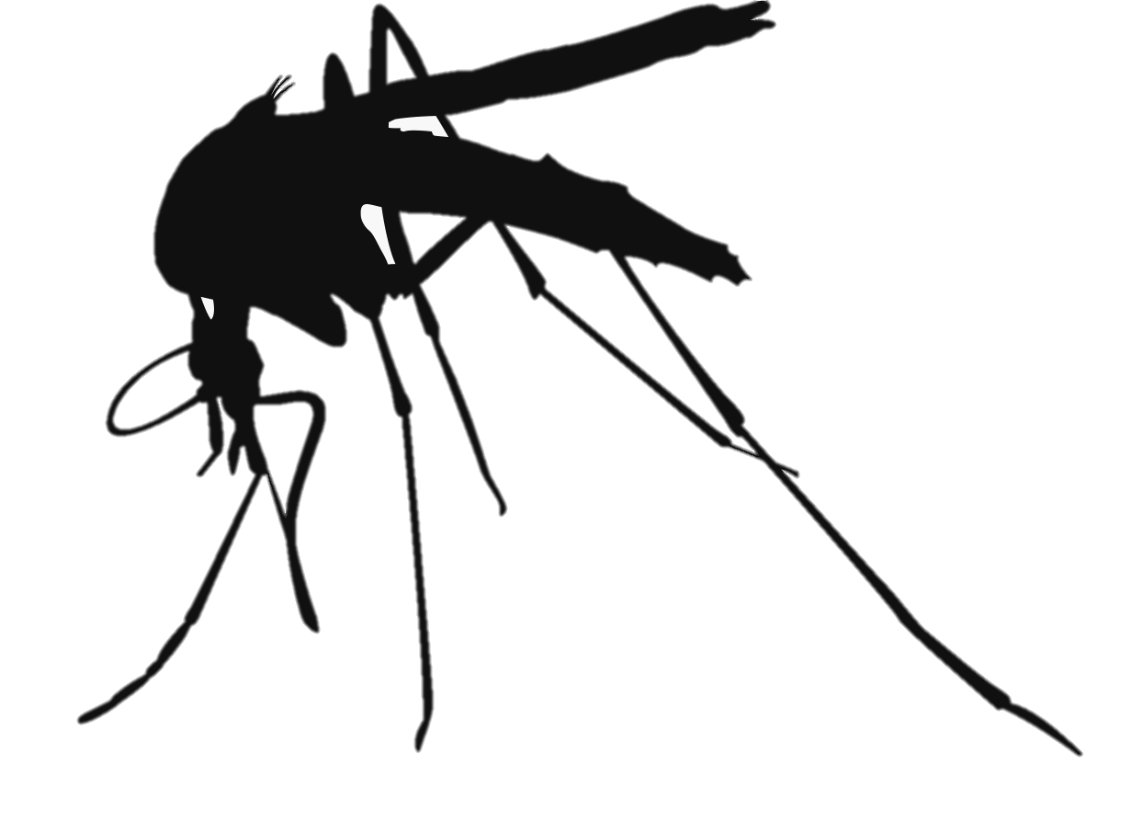
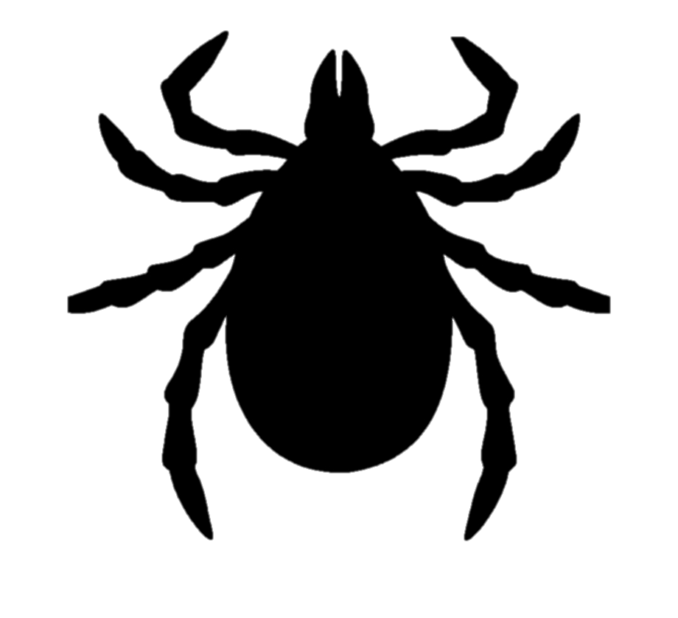
Important arbovirus distributions
Dengue virus
Yellow fever virus
Aedes spp.
Aedes spp.
West Nile virus
Chikungunya virus
Culex pipiens
Aedes spp.
Japanese encephalitisvirus
Venezuelan equine encephalitis virus
Culex pipiens
Culex -> Aedes
Crimean-Congo hemorrhagic fever virus
Rift-Valley fever virus
Culex and Aedes
Hyalomma ticks
Iranpour. 2016. Expert Reviews in Molecular Medicine

Slide 29
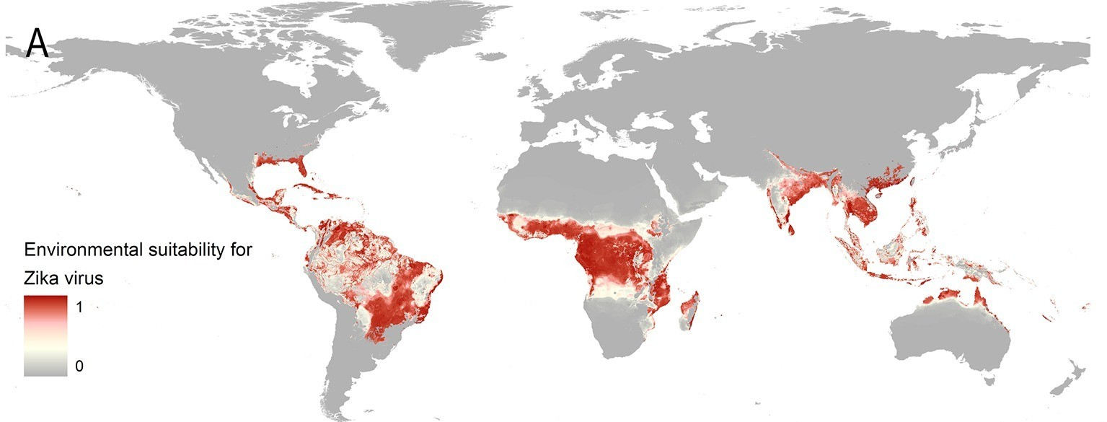
Zika is also vectored by Aedes aeygpti and its relatives
Messina et al 2016. eLife

Slide 30
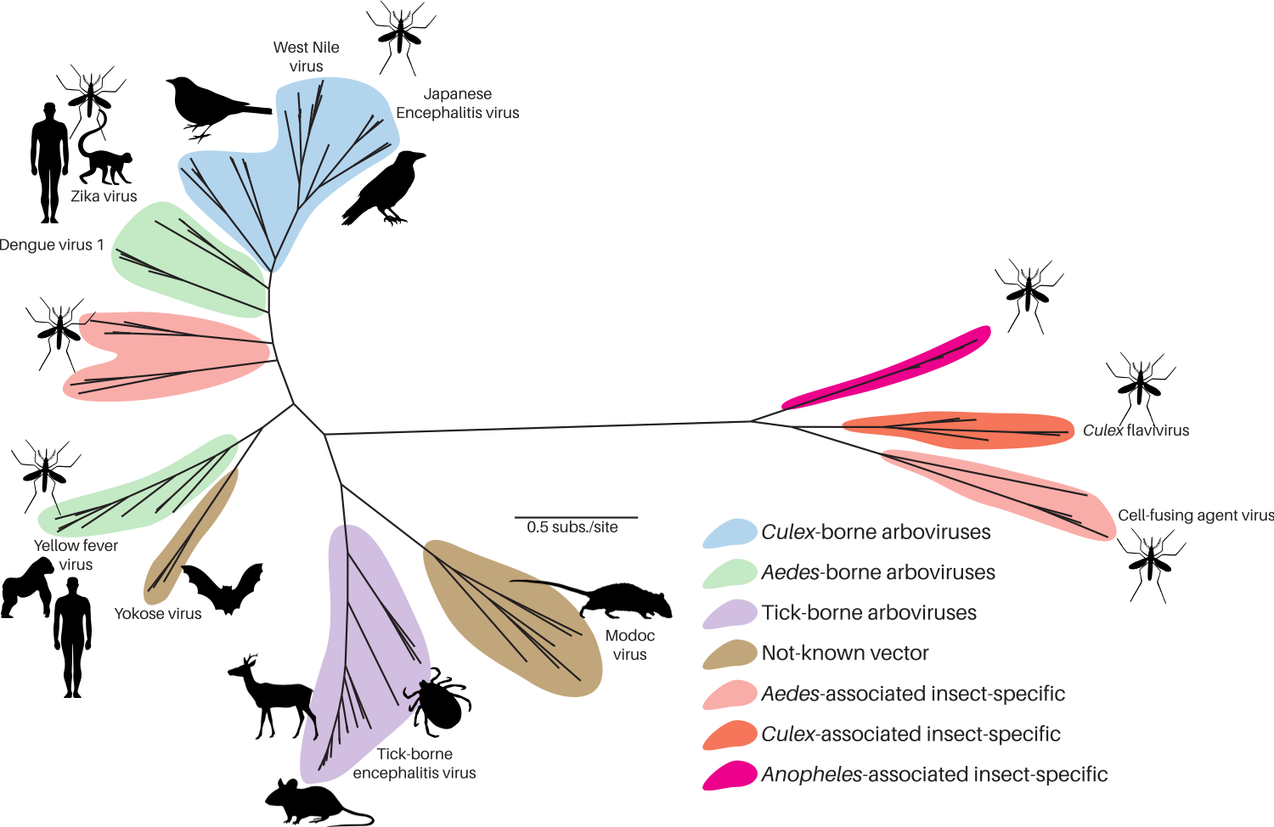
Arboviruses infect a wide range of hosts and vectors
Flavivirus viral genus phylogeny
Sebastian Lequime. 2020.

Slide 31
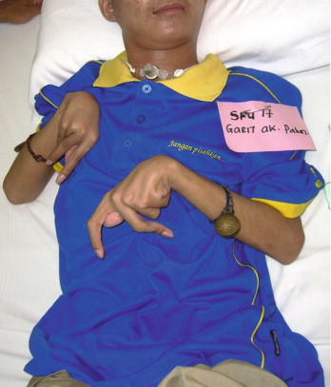
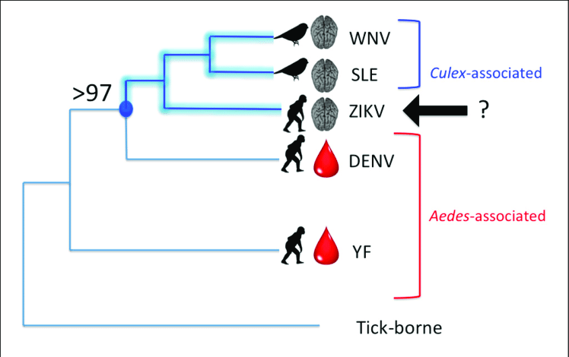
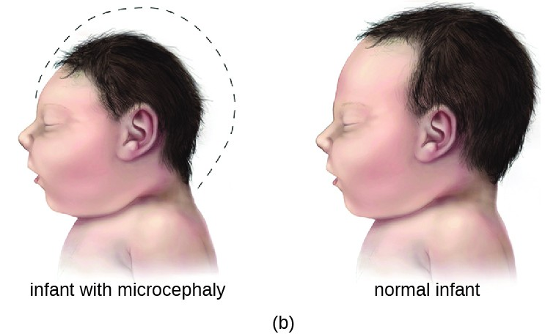
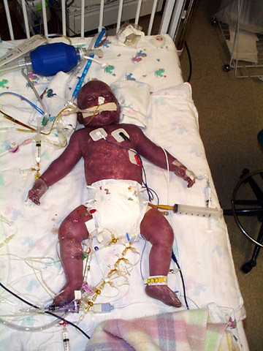
Arbovirus disease progression
Hunter. 2017. Frontiers in Micro
Notes:
Flaviviruses are among themselves diverse. They group by transmission, tick-borne, mosquito-borne, no –known vector, or insect specific (meaning they are transmitted between insects). They have a wide range of clinical manifestations such as hemorrhagic fever, encephalitis, paralysis, chronic arthraligia and more recently ZIKV has been shown to cause birth defects such as microcephaly. Importantly, most flaviviruses, are zoonotic and emerged into the human population from wildlife cycles the best example of which is Dengue virus.

Slide 32
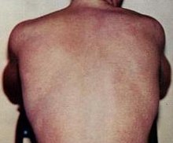
Dengue fever
Mosquito-borne disease caused by one of four known serotypes of dengue virus (DENV-1, -2,-3,-4)
A small proportion of cases develop into dengue hemhorrhagic fever (bleeding, blood plasma leakage) or dengue shock syndrome (dangerously low blood blood pressure)
Most severe cases occur in secondary infections resulting from antibody-dependent enhancement (ABD), a phenomenon whereby pre-existing immunity to a single serotype facilitates infection by a subsequent serotype
40% of the world’s population resides in dengue-endemic areas
Only one licensed vaccine: Dengvaxia (tetravalent vaccine which confers immunity to all 4 serotypes simultaneously
Licensed in 2016 but controversy developed after severe cases developed in those who were previously naïve in Philippines)

Slide 33
Dengue fever
Mosquito-borne disease caused by one of four known serotypes of dengue virus (DENV-1, -2,-3,-4)
A small proportion of cases develop into dengue hemhorrhagic fever (bleeding, blood plasma leakage) or dengue shock syndrome (dangerously low blood blood pressure)
Most severe cases occur in secondary infections resulting from antibody-dependent enhancement (ABD), a phenomenon whereby pre-existing immunity to a single serotype facilitates infection by a subsequent serotype
40% of the world’s population resides in dengue-endemic areas
Only one licensed vaccine: Dengvaxia (tetravalent vaccine which confers immunity to all 4 serotypes simultaneously
Licensed in 2016 but controversy developed after severe cases developed in those who were previously naïve in Philippines)

Slide 34
Dengue fever
Mosquito-borne disease caused by one of four known serotypes of dengue virus (DENV-1, -2,-3,-4)
A small proportion of cases develop into dengue hemhorrhagic fever (bleeding, blood plasma leakage) or dengue shock syndrome (dangerously low blood blood pressure)
Most severe cases occur in secondary infections resulting from antibody-dependent enhancement (ABD), a phenomenon whereby pre-existing immunity to a single serotype facilitates infection by a subsequent serotype
40% of the world’s population resides in dengue-endemic areas
Only one licensed vaccine: Dengvaxia (tetravalent vaccine which confers immunity to all 4 serotypes simultaneously
Licensed in 2016 but controversy developed after severe cases developed in those who were previously naïve in Philippines)

Slide 35
Dengue fever
Mosquito-borne disease caused by one of four known serotypes of dengue virus (DENV-1, -2,-3,-4)
A small proportion of cases develop into dengue hemhorrhagic fever (bleeding, blood plasma leakage) or dengue shock syndrome (dangerously low blood blood pressure)
Most severe cases occur in secondary infections resulting from antibody-dependent enhancement (ABD), a phenomenon whereby pre-existing immunity to a single serotype facilitates infection by a subsequent serotype
40% of the world’s population resides in dengue-endemic areas
Only one licensed vaccine: Dengvaxia (tetravalent vaccine which confers immunity to all 4 serotypes simultaneously
Licensed in 2016 but controversy developed after severe cases developed in those who were previously naïve in Philippines)

Slide 36
Dengue fever
Mosquito-borne disease caused by one of four known serotypes of dengue virus (DENV-1, -2,-3,-4)
A small proportion of cases develop into dengue hemhorrhagic fever (bleeding, blood plasma leakage) or dengue shock syndrome (dangerously low blood blood pressure)
Most severe cases occur in secondary infections resulting from antibody-dependent enhancement (ABD), a phenomenon whereby pre-existing immunity to a single serotype facilitates infection by a subsequent serotype
40% of the world’s population resides in dengue-endemic areas
Only one licensed vaccine: Dengvaxia (tetravalent vaccine which confers immunity to all 4 serotypes simultaneously
Licensed in 2016 but controversy developed after severe cases developed in those who were previously naïve in Philippines)

Slide 37
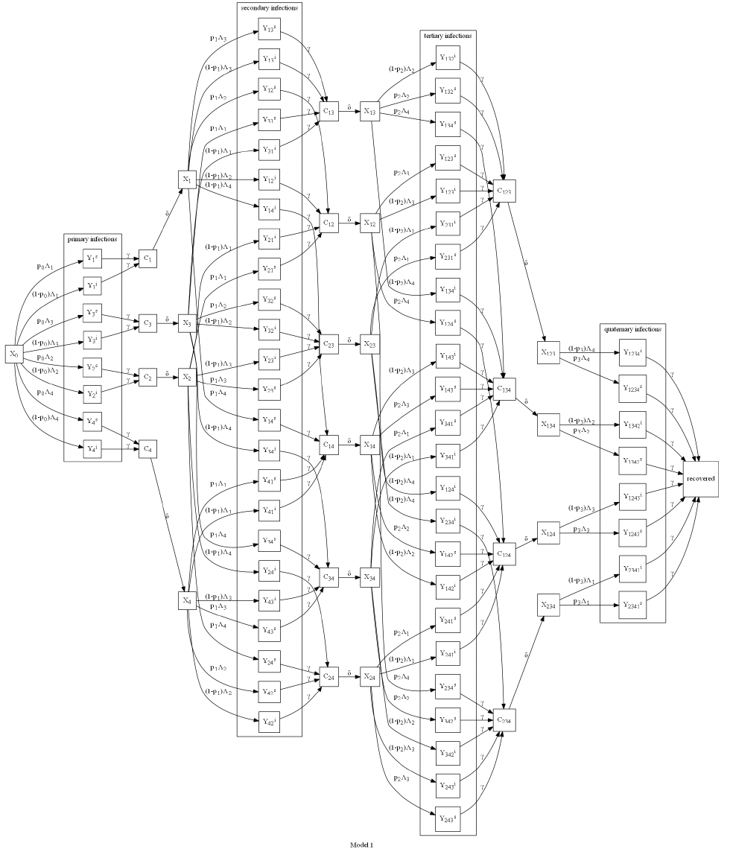
Modeling dengue
(at its most
complex!)
Alexander et al. 2021. PNAS.

Slide 38
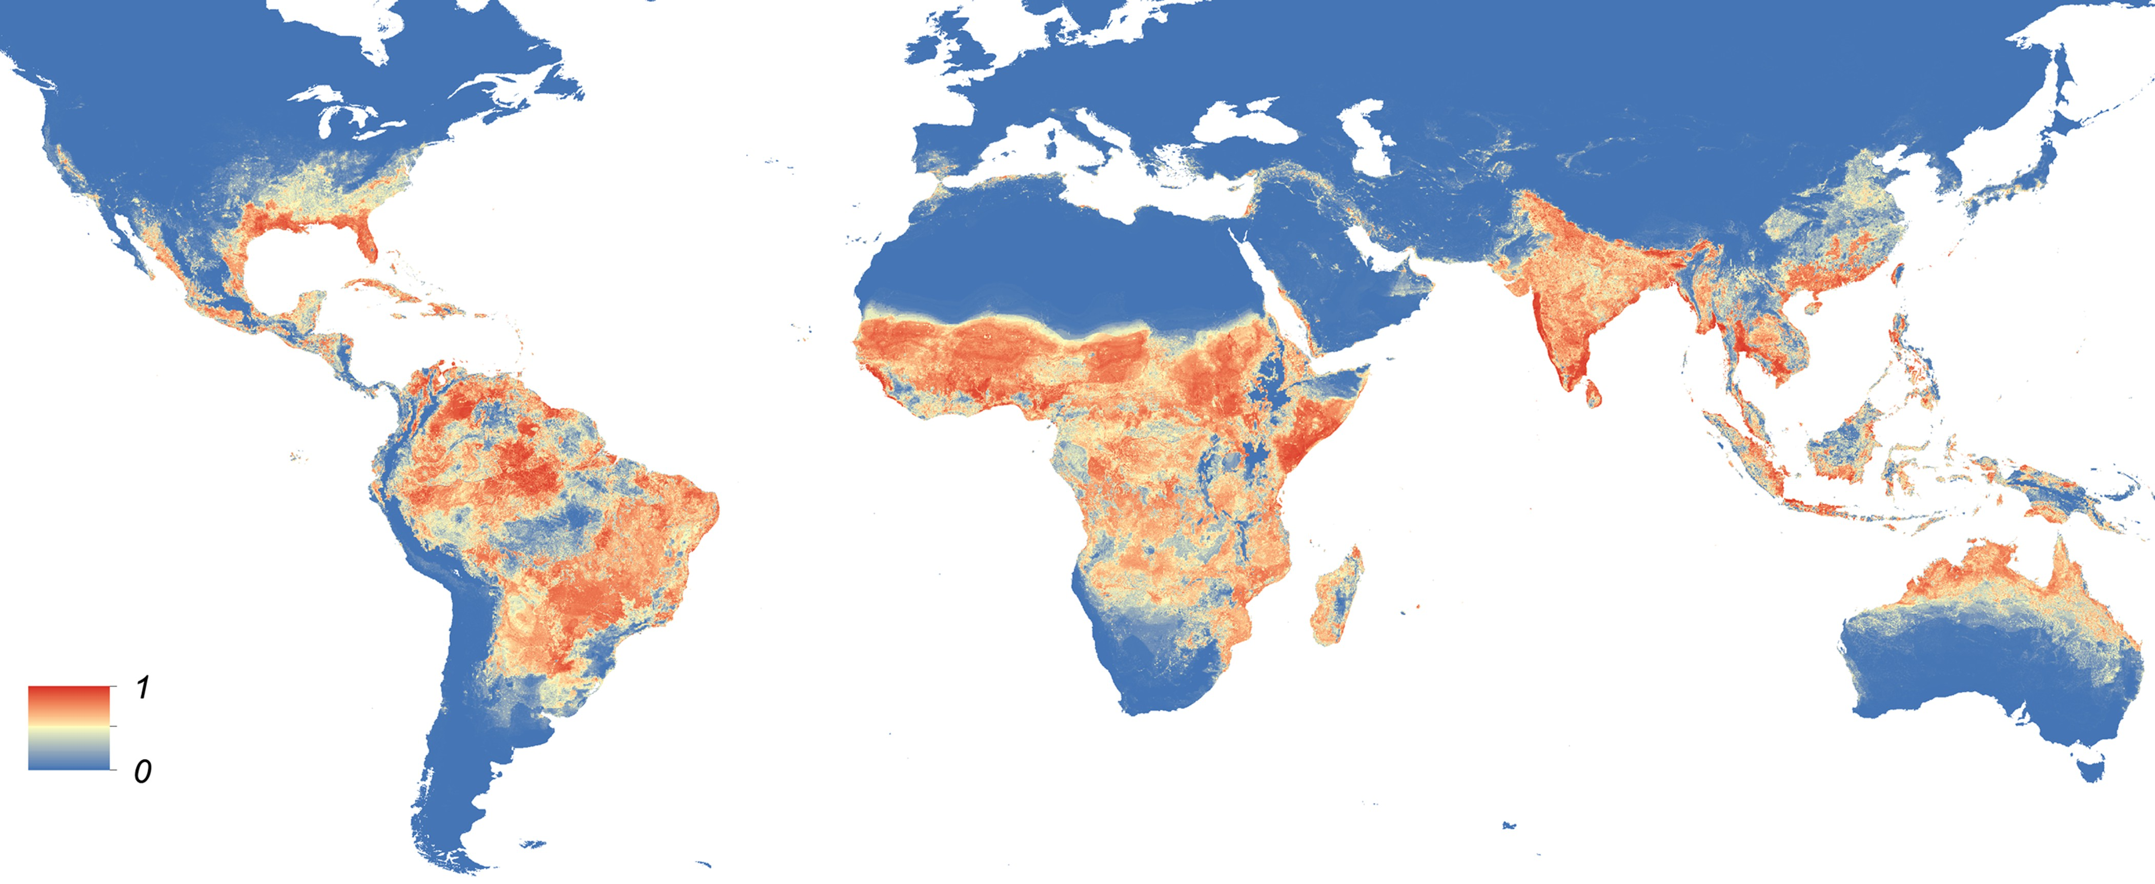
Global distribution of Aedes aegypti
Kraemer et al. 2015

Slide 39
Global distribution of Aedes albopictus
Kraemer et al. 2015

Slide 40
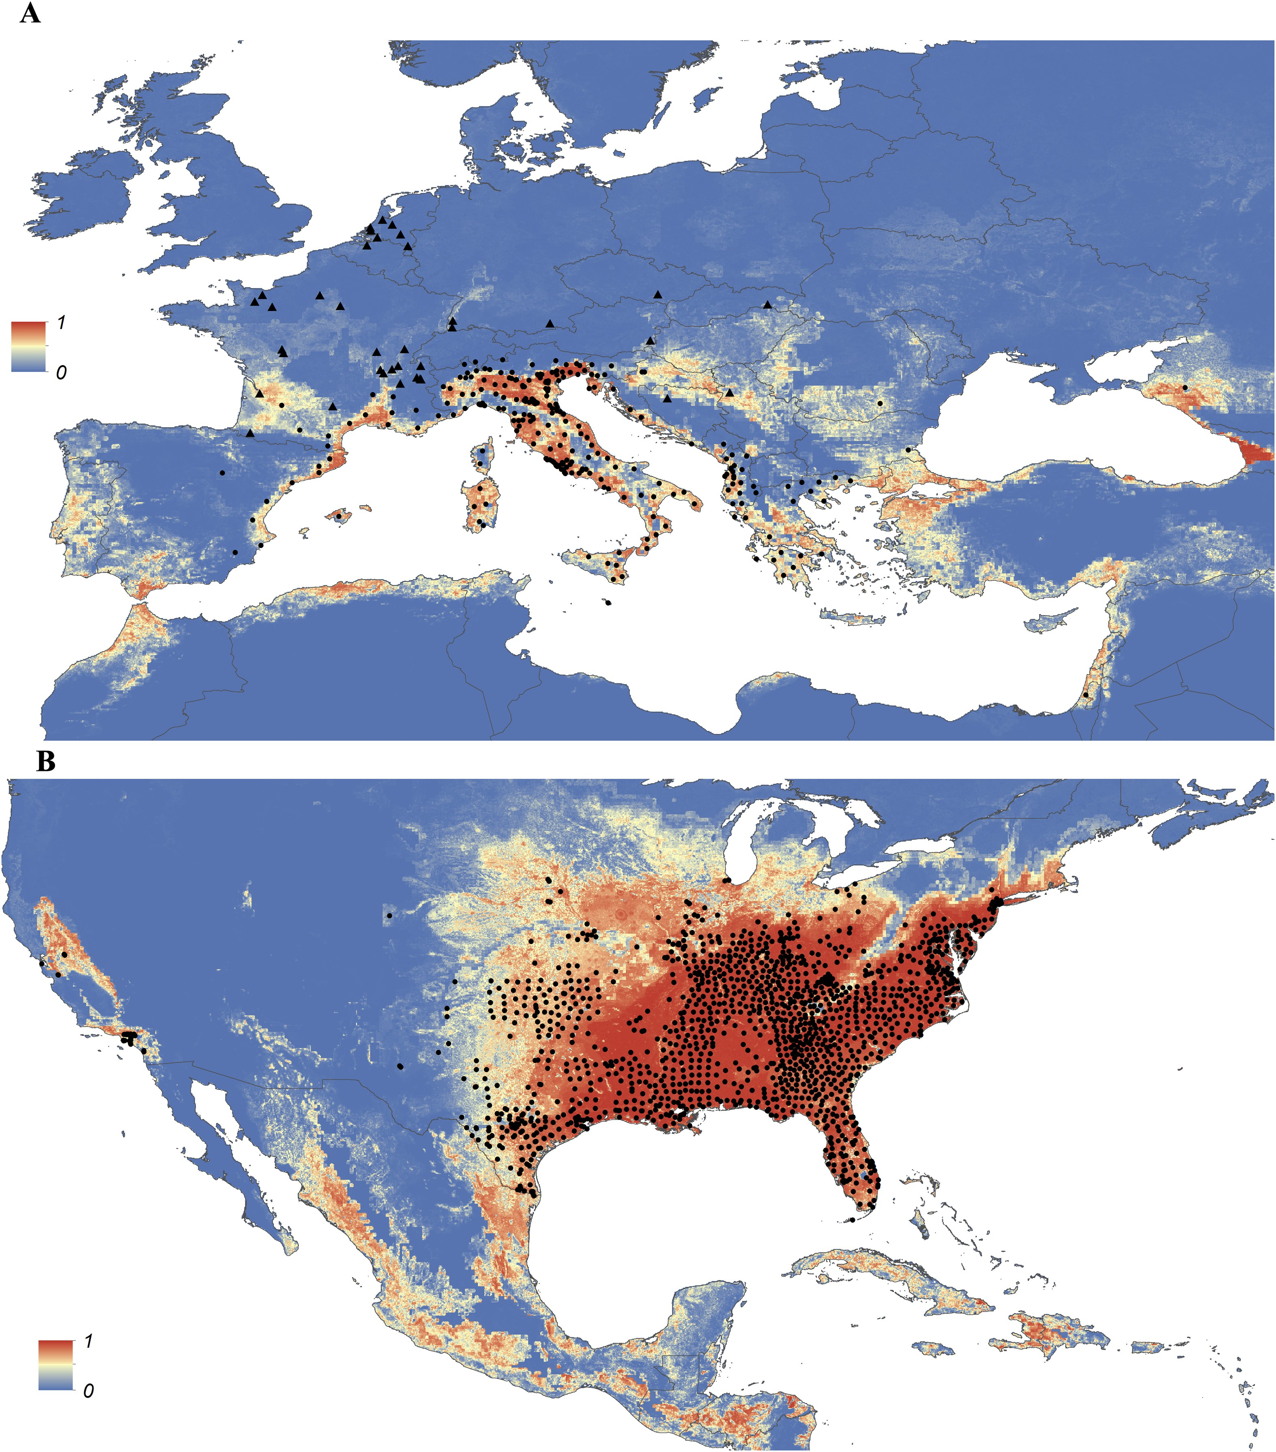
Detailed probability of occurrence of Aedes albopictus in Europe and US, areas where the mosquito is most rapidly expanding its range
Kraemer et al. 2015

Slide 41
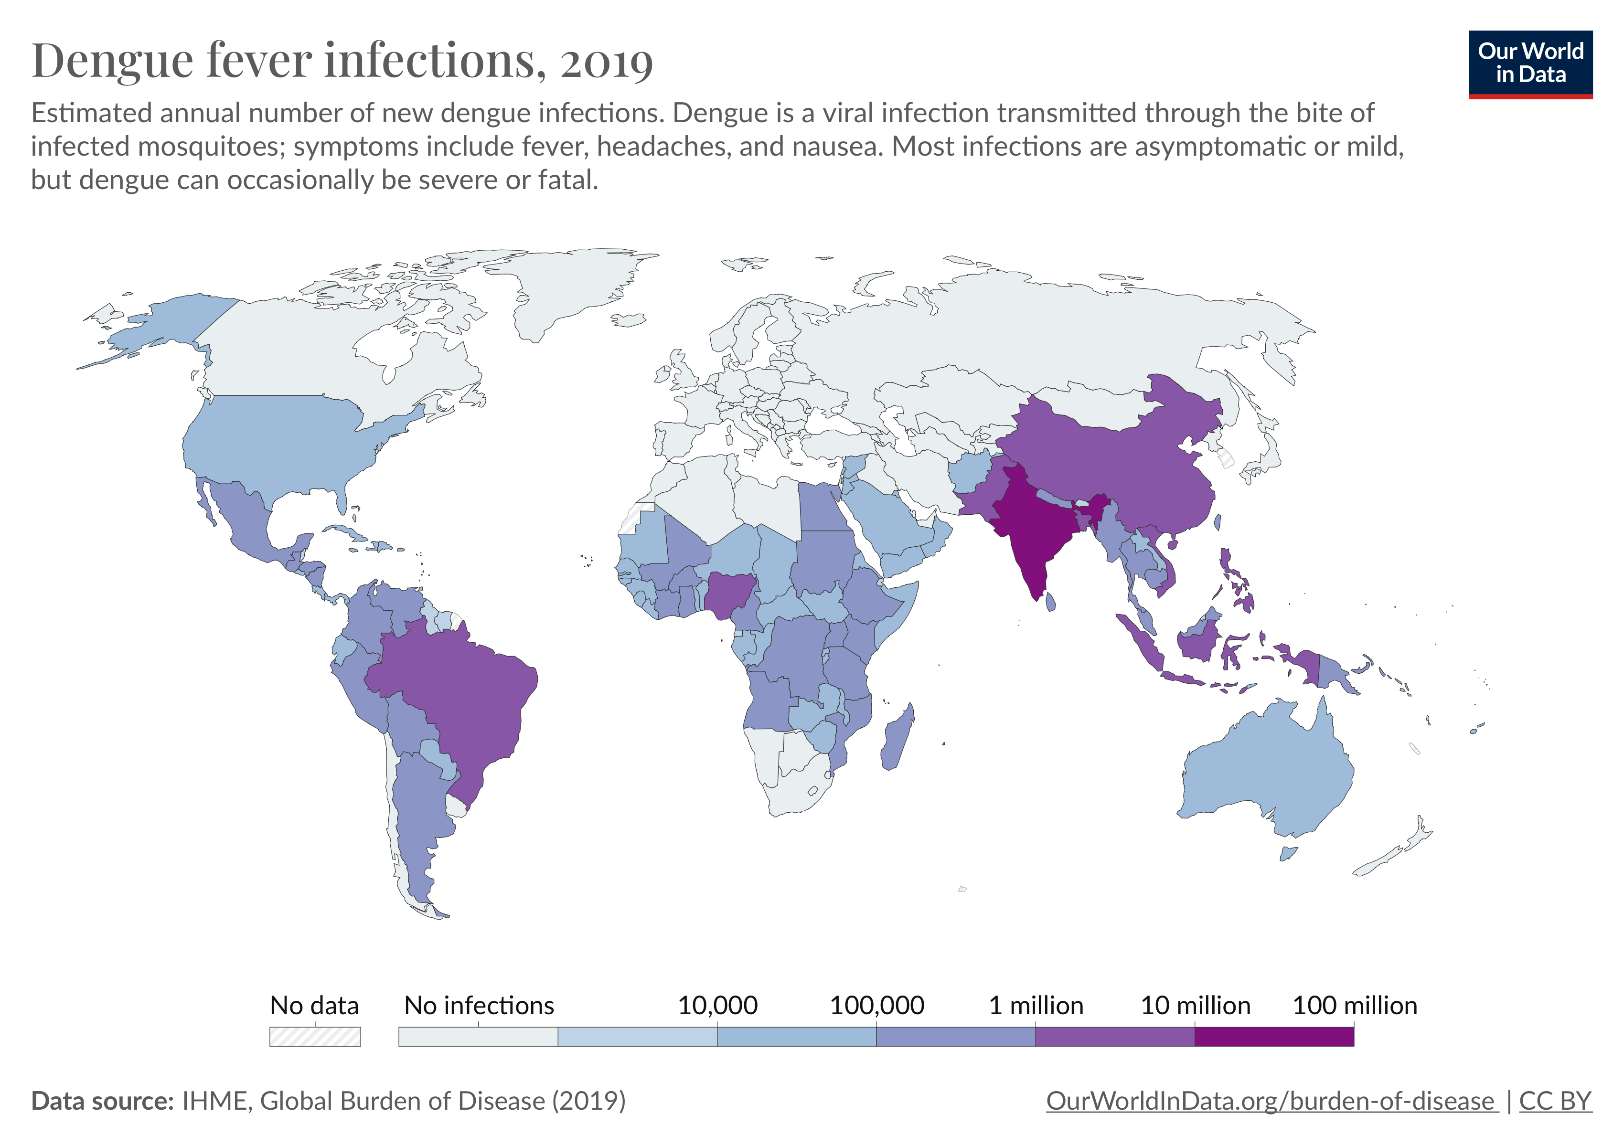

Slide 42
Pathogens exhibit diverse transmission mechanisms that require tailored modeling structures
Vector-borne diseases (a type of indirect transmission) are transmitted via blood-feeding arthropod (mosquitoes, ticks, fleas)
Malaria: Mosquito-borne protozoan Plasmodium spp.
“Arboviruses”: Mosquito-borne viruses, including Dengue, Zika, Yellow fever virus, West Nile virus, Chikungunya virus
Sleeping sickness, also known as African trypanosomiasis: tsetse fly vector and protozoan pathogen (trypanosome)
Chagas disease: kissing bug vector and trypanosome pathogen
Plague: flea vector and bacterial pathogen (Yersinia pestis)
Notes:
Kissing bugs = hemiptera = true bugs

Slide 43
Pathogens exhibit diverse transmission mechanisms that require tailored modeling structures
Vector-borne diseases (a type of indirect transmission) are transmitted via blood-feeding arthropod (mosquitoes, ticks, fleas)
Malaria: Mosquito-borne protozoan Plasmodium spp.
“Arboviruses”: Mosquito-borne viruses, including Dengue, Zika, Yellow fever virus, West Nile virus, Chikungunya virus
Sleeping sickness, also known as African trypanosomiasis: tsetse fly vector and protozoan pathogen (trypanosome)
Chagas disease: kissing bug vector and trypanosome pathogen
Plague: flea vector and bacterial pathogen (Yersinia pestis)
Plague is BOTH vector-borne and zoonotic!
Notes:
Kissing bugs = hemiptera = true bugs

